Slide 1
AAVAiL revenue projection – part 1 data investigation summary
RICHARD CURE
March-April 2021

Slide 2
contents

Slide 3
1. Assimilate the business scenariO
AAVAiL customers outside the US have been subscribing to AAVAiL services ‘a la carte’ e.g. which is different to the way they have been doing so before.
This has created ~ 2 years of transactional data across a few 1000 customers.
These customers are dispersed across 38 different countries, and the transactional data comes in batch format, 1 JSON file per month.
AAVAiL product mangers have found it difficult to predict monthly revenue.
Through a Design Thinking programme, a decision was made to start a new project to develop a machine learning model to project revenue for 10 of the 38 countries.
Product Manager expectations of the model are that it will save time over the existing revenue projections process, and that model outputs will be more accurate than outputs resulting from the existing process.
The possible positive business impacts are that the model will enable AAVAiL to stabilise counts of staff members, and will generate a ‘ripple effect’ drawn from budget projections.

Slide 4
1. articulate testable hypotheses.
Business Question | Hypothesis | Ideal Data needed | Data Descriptions
Does use of the new model save AAVAiL Product Managers time when projecting future revenue? | Use of the new model to generate a revenue projections is faster than use of the existing revenue projections process | 2 tables containing the below rows and columns, for pre- new model (existing process) and post-new model Rows: A single revenue projection made by an AAVAiL Product Manager Columns: Projection id Date/Time of projection Product Manager ID/Name Month of projection Country of projection Model version Model output/revenue projection(s) Time to execute projection | Projection id – uniquely identifies a projection Date/Time of projection – when the projection was executed Product Manager ID/Name – uniquely identifies a user Month of projection - month which the projection is for Country of projection – country which the projection is for Model version – version of model for which the projections was derived from Model output/revenue projection(s) - output of the model Time to execute projection – How long it took the user to execute the projection
Does the new model enable AAVAiL Product Managers to more accurately project revenue? | The new model projects more accurate revenue predictions than the predictions of the existing revenue projections process | 2 tables containing the below rows and columns, for pre- new model (existing process) and post-new model Rows: A single revenue projection made by an AAVAiL Product Manager Columns: Projection id Date/time of projection Product Manager ID/Name Month which the projection is for Country for which the projection is for Model version Model output/revenue projection(s) Actual revenue | See above row for existing descriptions Actual revenue – actual revenue for the month and country

Slide 5
2. State the ideal data to address the business opportunity and clarify the rationale for needing specific data.

Slide 6
3. Create a python script to extract relevant data from multiple data sources, automating the process of data ingestion.
See github repository for data-ingestor.py script
Psuedo code:
For each json file in the current directory
Read the file into a pandas dataframe
Combine dataframes into one
Fill NaN values from duplicate columns e.g. times_viewed vs TimesViewed
Check NaN values are filled – if so, drop duplicate columns
Save dataframe as csv file

Slide 7
4. Investigate the relationship between the relevant data, the target and the business metric.
In GitHub:
See the ‘EDA’ Jupyter Notebook
See the ‘EDA-gallery’ folder for visualisations

Slide 8
4.a) – column manipulations
The following EDA was done following data ingestion and aggregation of the monthly .json files provided into a single transactions.csv file.
Some of the data types initially created by pandas package were not optimal for further analysis, so the following data type and column manipulations were applied:
Country: object to category
Stream_id: object to category
Customer_id: float to category
Invoice: object to category
Unamed: 0: dropped/deleted as this was not useful
Date: a new column derived from day, year, and month
Year-month: a new column derived from year, and month to help with monthly aggregation of the target column price

Slide 9
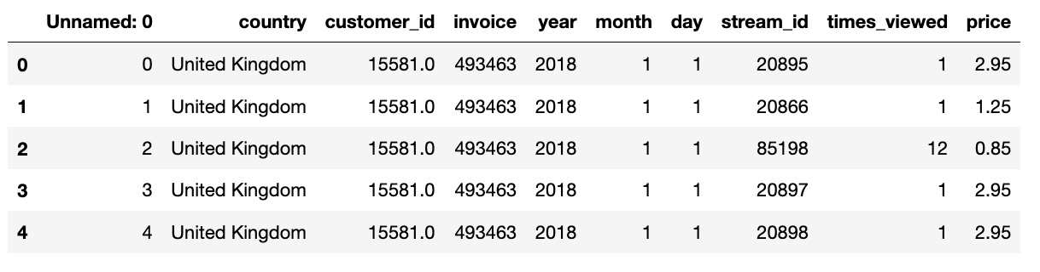
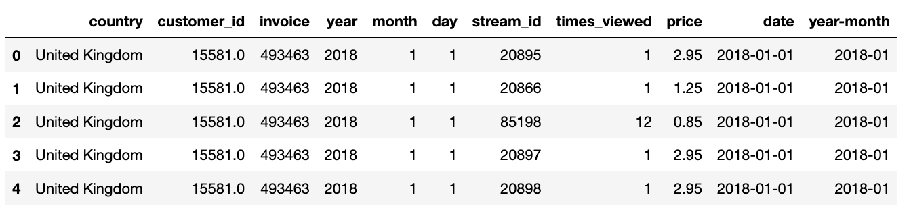
4.a) pre vs post manipulation

Slide 10
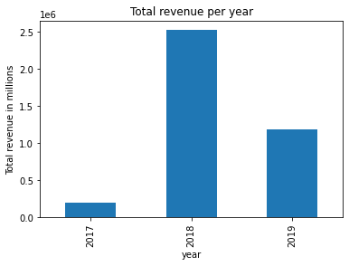
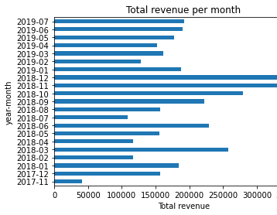
4.b) groupbys
The data was grouped by date, year, and month to allow aggregation of price(revenue) over time
The groupby of date was saved as ‘transactions_date_index.csv’
Total revenue company wide (all countries) was visualized per year and month
Takeaways:
Most of the revenue came in 2018. The least revenue came in 2017, but expected as only 2 months in 2017
Revenue peaked in the run up towards Christmas in 2018
Excluding Nov-17, Oct-18, Nov-18 and Dec-18 , monthly revenue for AAVAiL fluctuates between 100,000 and 275,000

Slide 11
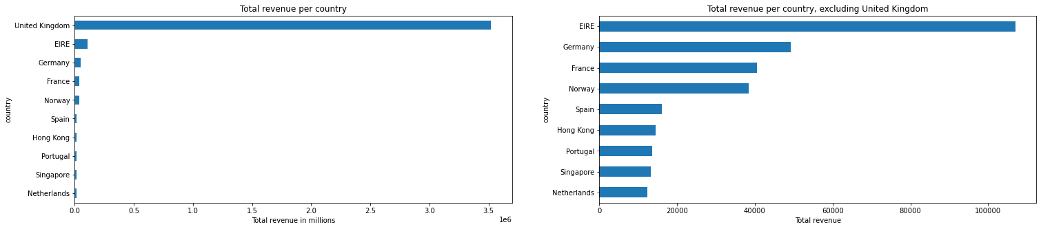
4.b) groupbys cont.
Data was also grouped by country, to find the top 10 revenue countries as specified in the business opportunity
Total revenue per country was calculated and ordered to produce this list of top 10 countries:
United Kingdom 3521513.51
EIRE 107069.21
Germany 49271.82
France 40565.14
Norway 38494.75
Spain 16040.99
Hong Kong 14452.57
Portugal 13528.6
Singapore 13175.92
Netherlands 12322.80
Revenue per country was visualised twice, excluding UK the second time
Takeaway: UK has 32 times the total revenue than second highest Ireland (“EIRE”). Ireland has roughly double revenue of third place country Germany

Slide 12
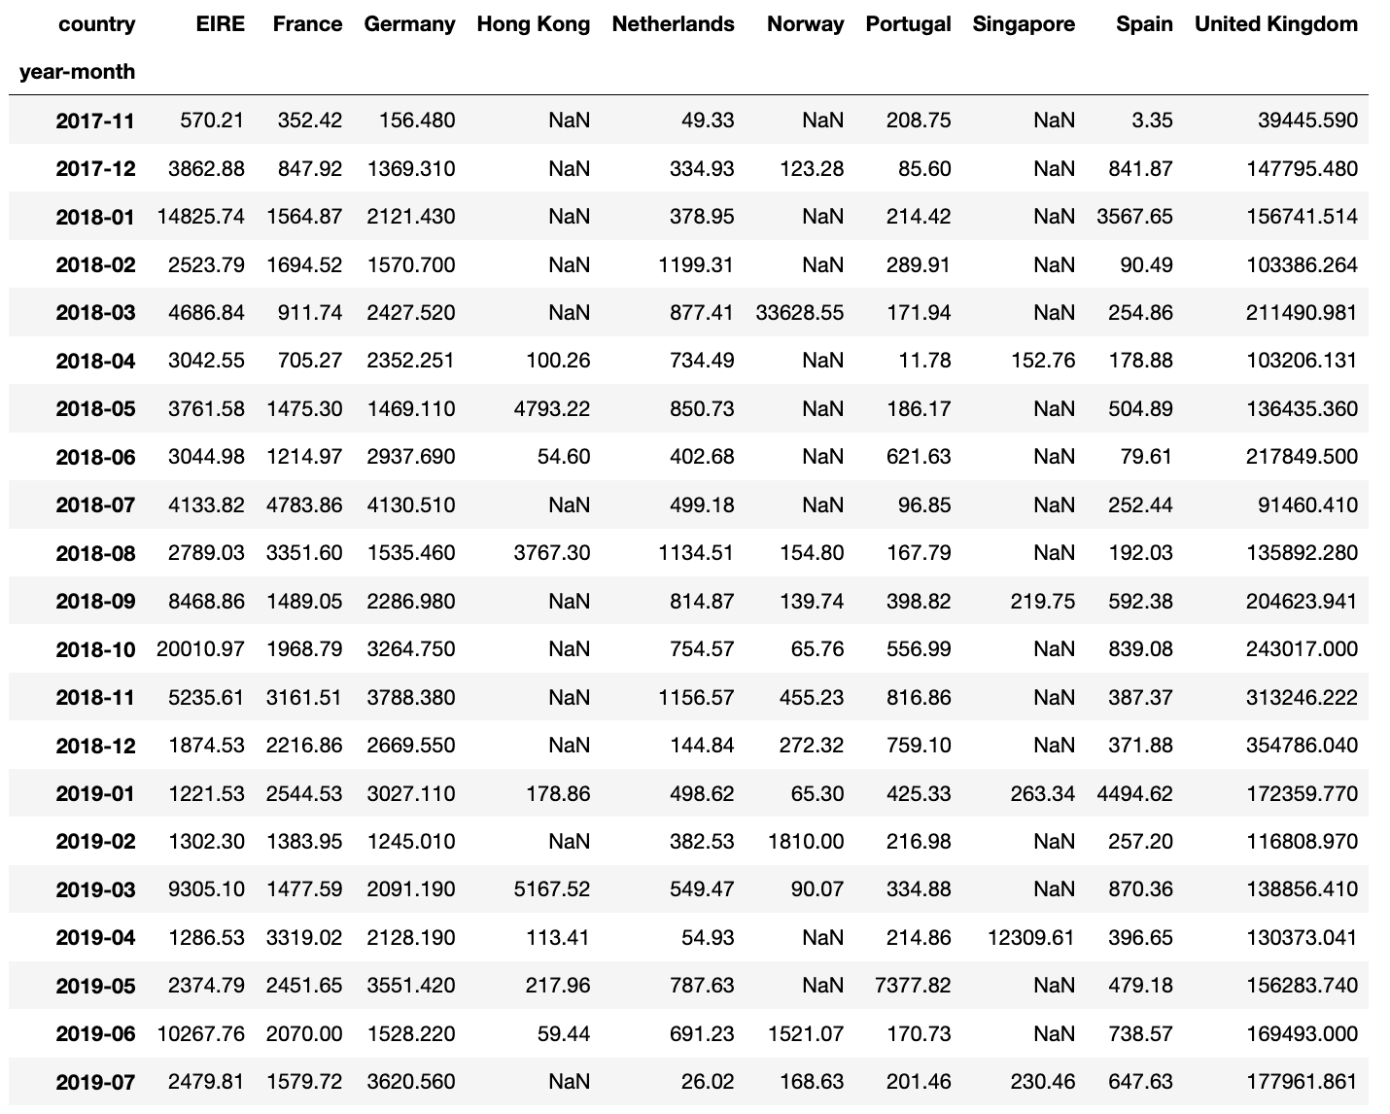
4.b) groupbys cont.
Data for these top 10 countries was grouped by country again, and indexed on month, to provide the monthly revenue totals per country.
This was saved as ‘monthly_revenue_totals_per_top10_country.csv’

Slide 13
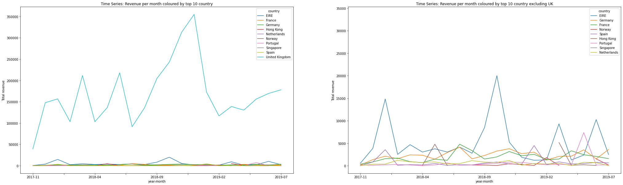
4.c) top 10 countries revenue per month visualised
This table was used to visualize revenues per top 10 countries over time as a time series/line graph.
Takeaways: Revenue for the UK peaks yearly around Christmas, and is between 100k and 250k outside of Christmas . This clearly shows month on month, the UK is the biggest market for AAVAiL.
Ireland’s revenue also peaks in December in 2017 & 2018. There are further spikes in March 2019 and June 2019, but outside of these peaks, stays below 5k / month.
Revenue for the other 8 countries doesn’t vary much and generally, stays below 5k a month.

Slide 14
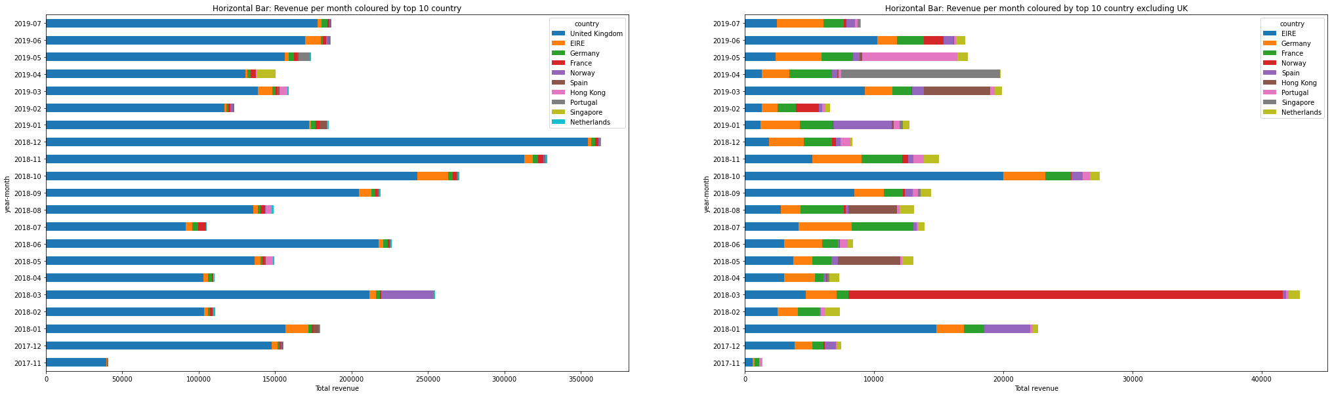
4.c) top 10 countries revenue per month visualized cont.
This table was also used to visualize revenues per top 10 countries over time as a stacked horizontal bar chart,
Takeaways: This graph shows what we learn from the previous slide, with the addition that Norway had 30k worth of transactions in March 2018.
The other notable points are Singapore’s large share of the company revenue in April 2019, and Portugal in May 2019.

Slide 15
4.d) distributions of price and times_viewed
Histograms were plotted for the numeric variables to view their distributions across the

